Slide 1
API & Microservices Overview
Prepared for the DevCoP

Slide 2
Agenda
Day 1 - Overview
APIs
Microservices
API Store
Day 2 - Deep dive
REST API
Security
Demos

Slide 3

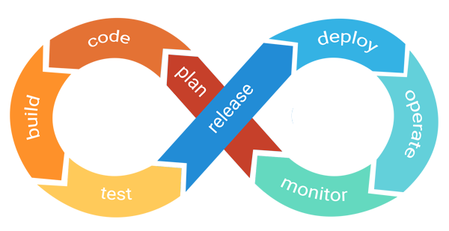
Drivers
GC Direction
GC Standards on APIs
TBS Mandatory Procedures on APIs
GC API Store (2019)
New channel to bring business value
Open Data - GC IT Strategy Plan
Industry adoption and expectations
Agile/DevOps
Notes:
Agile/DevOps
Improve deployment frequencies
Small units of work
Achieve Faster time to market
Improve Cycle Times
Reduce Lead Times and Handoffs
Lower failure rate of new releases
Lower time to recover and remediate vulnerabilities

Slide 4
What’s an API?
Application Programming Interface
Interface for a system to expose its capabilities to other systems for their consumption, to access:
Data/Information
Execute functions
Consumers and Providers
Contract
APIs vs Web APIs

Slide 5








Slide 6
What’s a Microservice?
Architectural pattern/design that separates an application (usually monolithic) into small, self-containing components
Implemented and deployed independently
Arranges an application as a collection of loosely coupled services
APIs are used to expose the microservice

Slide 7
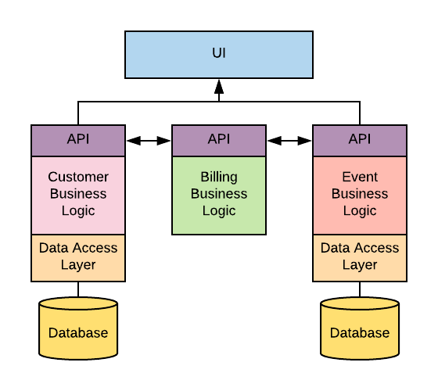
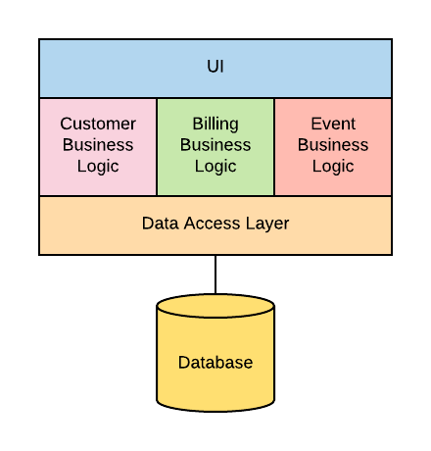
VS

Slide 8
Why do we want them?
Easier to
Develop, test, deploy
Monitor, troubleshoot
Maintain
Integrate (lightweight protocol)
Consume (mobile, web apps etc.)
Opportunity To:
To start integrating modern development practices
Automation
Facilitate CI/CD
Decouple your solution
Re-structure your team Conways Law
Review your Data Topology
Scalability
Implemented and deployed independently of each other
Run within independent processes
Monitored and scaled independently

Slide 9

Applicable to GC?
Complexity of our systems
Legacy Systems
Information Sharing
Opportunities for 3rd parties
(QuickTax, Auto Recalls, Health Drug DB)
Expose data from sources of truth
User Centric
Tailored services based on exposed sources of information
Improve time-to-market
Incremental Value (No Big Project!)

Slide 10



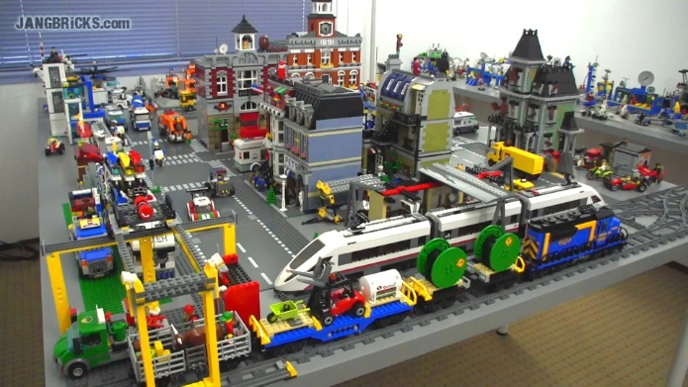
APIs are your building blocks!

Slide 11
What is REST?
Representational State Transfer
Software architectural style for creating Web APIs with a set of constraints
Client-Server, Stateless, cacheable, uniform interface…
Leverages existing web standards
HTTP verbs, Headers, URI, JSON, XML…
RESTful: An API that conforms to the REST constraints

Slide 12
Components of a RESTful API
https://my-service.com/api/v2/countries?commonwealth=true
Path
URI used to target a resource
Resource
Unit of data (entity, data object)
Can include optional parameters (filtering, sorting, pagination….)
Verb
Performs the action on the resource
Uses standard HTTP Methods (Get, Post, Put, Delete…)
Retrieve: GET /teams/24/players
Insert: POST /teams/24/players
Headers
Key + Value pairs included in a the HTTP message
Defines information about the transportation, contents, consequences, etc of a message (Accept-Language, Last-Modified…)
Status Codes
States the results of the call
Uses standard HTTP Status Codes (200, 300, 400…)

Slide 13
SOAP Services vs REST APIs
Both used to exchange data over web, but they do it differently
Simple Object Access Protocol | REpresentational State Transfer
Is a messaging protocol | Is a software architecture style with constraints to comply to
Uses business operations GetProvinceList UpdateProvince | Uses an action (http verb) with a resource Get /Provinces Post /Provinces
Payloads: XML | Payloads: Any web safe format (JSON, XML, HTML, CSV, plaintext…)
Contract: WSDL | Contract: Several options exists (Swagger/OpenAPI, RSDL, RAML)
Transport over many protocols (HTTP, SMTP, JMS) | Transport over HTTP (Transport over non-HTTP protocols is possible, but not standardized)

Slide 14
SOAP vs REST Operations
Operation Description | SOAP Web Service | REST API
Get all claims | GetAllClaims | GET /claims
Get a claim | GetClaimDetails(4324) | GET /claims/4324
Get all claims submitted after a date | GetAllClaimsAfterDate(“2015-01-01”) | GET /claims?submitDate=“2015-01-01”
Submit a new claim | SubmitClaim | POST /claims
Check if a claim is eligible | IsEligible(4324) | GET /eligibility?claimId=“4324” or GET /claims/4324/eligibility
Process the claim | ProcessClaim(4324) | POST /claims/4324/process
 |  | GET /teams/41/quarterbacks GET /quarterbacks/83/teams

Slide 15
XML vs JSON
Both standardized format for storing and/or exchanging data
eXtensible Markup Language | JavaScript Object Notation
Specialises in defining data | Specialises in exchanging data
Heavyweight syntax to promote comprehensive representations of information | Lightweight syntax to promote quickly transferring information
Stores information in elements, uses the Tree data structure | Stores information in key/value pairs, uses the Map data structure
Can be extended to have any number of defined datatypes | Has a set of fixed datatypes (String, number, object, array, boolean, null)
Schema files allows for validation of payloads
Transformations have a dedicated language (XSLT) | Transformations are done programmatically

Slide 16
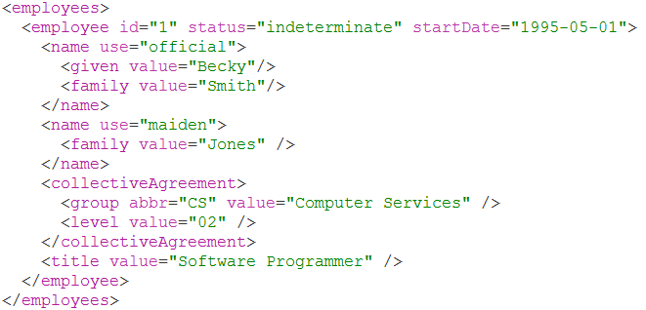
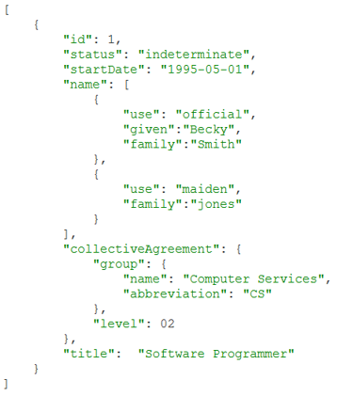
XML vs JSON

Slide 17
How do we design them?
System A
System B
System C
System D
Operation | HTTP Verb + Resource
Get All | GET /Provinces
Get Specific | GET /Provinces/ON GET /Provinces?OfficialLanguage=“french”
Insert | POST /Provinces
Update | PUT /Provinces/ON
Delete | DELETE /Provinces/ON
Patch | PATCH /Provinces/ON
Provinces

Slide 18


Job Bank
Web Site
Job Alert
MSCBA
MSCA
Labour
EI
Applications
Doc Upload
Search
Notification
Translation
Matching
BN Validation
(CRA)
Search Engine
Clients
Employers
Jobs
Notes:
Chattiness
REST calls are cheap, so no need to limit them
One call is one resource
Many resources require many calls
Separation of data
Split data into logical resources
Client chooses necessary resources instead of receiving all data
Can restrict resources to only specific clients
May contain links to additional resources/actions
Separation of operations
Split operations into Verbs and Paths
Client doesn’t need a list of valid methods, can create operations based on logical combinations
Can restrict operations to only specific clients
Optionality within operations
Add optional parameters to operation instead of creating new operations

Slide 19
Operationalizing Considerations
Increased number of solutions to support
Complexity in managing dependencies/versions
Monitoring to effectively maintain, operate and support
Scaling
Network Latency
Hosting of your API
Security
Transaction tracking

Slide 20
GC API Store

Slide 21
GC API Store
Managed by: ISED (Industry)
Hosted: AWS
Technology: 3Scale By RedHat
DEV and Prod
20 APIs from 5 Departments
https://api.canada.ca/en/homepage

Slide 22

Components
Catalogue
Discoverability
Subscription
Document
Management Console
Publish and manage
Security / Access Control / Authentication
Monitoring / Throttling
Logging / Auditing
Reporting
Gateway
Routing
Connectivity
API Store
Catalogue
Management Console
Gateway

Slide 23


Publish / Subscribe
API Store
API Provider
API Consumer
Discover
Subscribes
Publish
Manage
APIs on Sale!
API Key
Endpoint
Integrate
Catalogue
Consumer System
Management Console

Slide 24
Call Flow
Management
Authentication
Access Control
Analytics
Consumer
System
Gateway
API

Slide 25
Hosting
AWS Cloud
Management
External Consumer
System
Gateway (Public)
On-Premise/Cloud
Public Zone
API
King Edward DC
GC Consumer
System
Gateway (GC)
Business Zone
API
Data Zone
API

Slide 26
Hosting with Dept. Gateway
AWS Cloud
Management
Gateway (Public)
On-Premise/Cloud
External Consumer
System
Gateway (Public)
Business Zone
API
GC Consumer
System
Gateway (GC)
Data Zone
API
Internal Consumer
System
Gateway (Local)

Slide 27
Authentication/Authorization
Token
API Key, unique value that identifies the consumer (person/system)
Used by management console to manage access/permission
Unique Value
If compromised no way of protecting your API
Fine for reading data
OAuth
Open standard for access delegation
Is its own service, that generates a token based on your credential. From then that token is used to authenticate to your API.
Is more secure
Generated token expires
Good for APIs that allow the manipulation of data or accesses sensitive data

Slide 28
Documentation
Swagger
Describes the structure of your APIs so that machines can read them
Used to document your API
Can be used to generate client libraries
Leveraged by testing tools
Adheres to OpenAPI Specification

Slide 29

Thank you!

Slide 30
Reference Material
GC API Store
TBS API Guidelines
GC Standards on APIs
GC Digital Standards
https://www.getpostman.com/
https://swagger.io/solutions/api-design/

